Slide 1
Pol Pot vs. Macbeth
Mitch B. & Paige S.

Slide 2
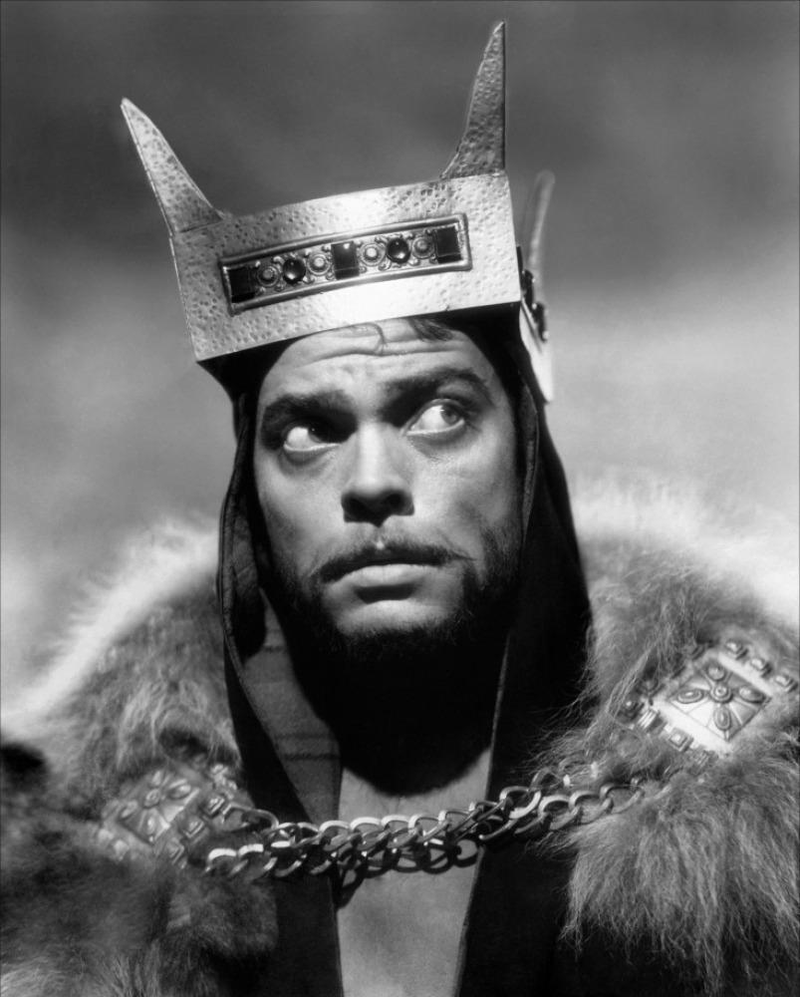
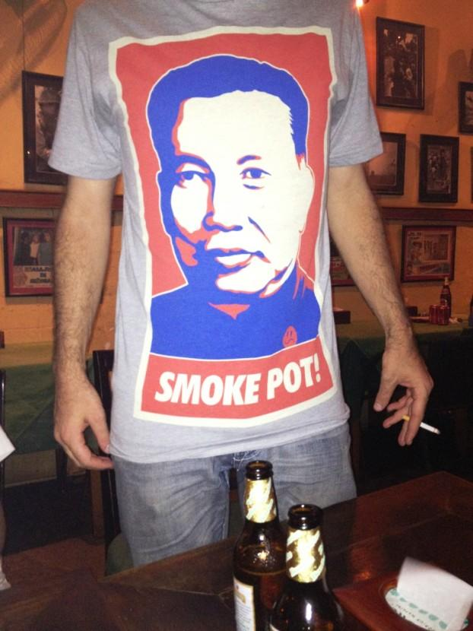
Similarities
Vs.

Slide 3
“I have done the deed.” (II.ii.15)
Both Macbeth and Pol Pot rose to power by seizing it from those who were in power previous to them.
Macbeth
- Macbeth did this by murdering Duncan, and assuming his throne.
Pol Pot
- Pol did by leading an army to seize Phnom Penh (the capital of Cambodia).

Slide 4
“Masking the business from the common eye/For sundry weighty reasons.” (III.i.128-129)
Macbeth and Pol Pot were both deceiving and put on a false persona.
Macbeth
- This is shown by Macbeth when he hires murderers to kill Banquo in order to appear innocent to all his peers.
Pol Pot
- Pol Pot worked as a teacher during the day and was applauded for his enthusiasm and generous methods. During the night he worked, along with other marxist, to create what eventually led to the formation of the Khmer Rouge.

Slide 5
“It is concluded. Banquo, thy soul’s flight,
If it find heaven, must find it out tonight.”(III.i.146-147)
Both Macbeth and Pol Pot became mad with power and increasingly paranoid, which eventually led to them killing those who they once cherished.
Macbeth
- Macbeth became very paranoid because of his lust of power and due to what Banquo knew. Macbeth took his knowledge as a threat to the throne, which led to Macbeth plotting against and murdering the man he once was such close friends with.
Pol Pot
- Pol ordered the execution of several Khmer Rouge leaders because he became very paranoid and feared that they were plotting against him. Among these leaders were some of his closest friends who had been there since the start to help build and establish the Khmer Rouge

Slide 6
“Seize upon Fife, give to th’ edge o’ th’ sword/His wife, his babes, and all unfortunate souls/That trace him in his line” (IV.i.158-160)
Both Macbeth and Pol Pot had a complete disregard for human life
Macbeth
- Macbeth ordered the murder of an entire bloodline just because it was assumed that one of the members of that family may pose a threat to his throne.
Pol Pot
- Pol Pot murdered millions through torture, over working, starving, and dehydration. He later stated “Look at me now, am I a savage person? My conscious is clear.”

